Slide 1

\
collegeSHRI SHAMBHUBHAI V. PATEL COLLEGE OF
COMPUTER SCIENCE & BUSINESS
MANAGEMENT
of computer science &business management
brain chip technology
Brain chip technology
SUBMITED BY:
SANGANI HASTI HITESHBHAI
SEAT NO: 3366

Slide 2
Content
Introduction
history
Brain chip application
Brain chip diagrams and figures
Brain chip related comparative technology
Advantage
Disadvantages
future enhancement of brain chip
Diagram
Conclusion

Slide 3
Introduction
Brain chip technology, also known as brain-computer interface (BCI), is an emerging field that enables direct communication between the human brain and external devices.
These neural implants are designed to restore lost neurological functions, enhance cognitive abilities, and enable seamless interaction with digital systems.
This technology operates by recording and interpreting neural signals using electrodes implanted brain.
Machine learning algorithms then translate these signals into actionable commands for external devices
Future research aims to refine the safety, efficiency, and accessibility of brain chips, potentially leading to widespread adoption in medical and non-medical domains.

Slide 4
history
In the 1960s, neuroscientists like José Delgado conducted experiments demonstrating that electrical stimulation of the brain could influence behavior
In 1988, the first successful EEG-based BCI system was demonstrated, allowing subjects to control a cursor on a screen.
In the early 2000s, DARPA (Defense Advanced Research Projects Agency) funded neuroprosthetics research for military and medical applications.
In 2004, the first human patient received a BrainGate implant, allowing them to move a computer cursor using thought alone.
In 2023, Neuralink received FDA approval for human trials, marking a major milestone.
In January 2024, Neuralink successfully implanted its brain chip in a human patient, who demonstrated the ability to control a computer cursor through thought.

Slide 5
Brain chip Application
1. Medical Applications
✅ Restoring Mobility for Paralyzed Patients
BCIs allow individuals with spinal cord injuries or paralysis to control robotic limbs, wheelchairs, or computers using their thoughts.
Example: Neuralink and BrainGate have demonstrated successful control of cursors and robotic arms by paralyzed individuals.
✅ Treating Neurological Disorders
Brain chips can help Parkinson’s disease, epilepsy, and Alzheimer’s by stimulating specific brain regions.
Example: Deep Brain Stimulation (DBS) is already used for treating Parkinson’s symptoms.

Slide 6
Brain chip Application
2. Communication & Accessibility
✅ Mind-Controlled Typing & Speech Assistance
BCIs help patients who cannot speak or type due to paralysis or neurological diseases.
Example: In 2021, a paralyzed man used a BCI to type words at 90 characters per minute using only his brain signals.
✅ Brain-to-Text and Thought Communication
Future brain chips may allow people to send messages or emails just by thinking.

Slide 7
Advantages
1. Medical Benefits
✔ Restoring Mobility: Helps paralyzed individuals control prosthetics and wheelchairs using thought. 2. Enhanced Human Abilities
✔ Mind-Controlled Devices: Enables hands-free operation of smartphones, computers, and even AI-powered robots. 3. AI & Digital Integration
✔ Merging with AI: Humans could access real-time information from the internet directly in their minds. 4. Military & Security Applications
✔ Mind-Controlled Drones & Weapons: Could assist soldiers in high-risk environments.

Slide 8
Disadvantages
1.Health Risks
⚠ Brain Damage & Surgery Risks: Implanting a chip requires surgery, which carries risks like infection or tissue damage. 2. Ethical & Privacy Concerns
⚠ Brain Hacking & Data Theft: If hacked, personal thoughts and memories could be stolen or manipulated. 3. High Costs & Accessibility
⚠ Expensive Technology: Brain chip implants and maintenance may be too costly for most people.

Slide 9
future enhancement of brain chip
1. AI-Integrated Brain Chips 🤖
🔹 Future chips will have AI-powered cognitive augmentation, allowing users to access and process information instantly. 🔹 AI can enhance memory, creativity, and decision-making, similar to a digital assistant inside the brain.
2. Wireless & Non-Invasive Brain Chips 📡
🔹 Current BCIs require surgical implantation, but future chips may use non-invasive techniques (like wearables or injectable nanobots). 🔹 Example: Synchron’s Stentrode uses blood vessels to place electrodes in the brain without surgery.

Slide 10
future enhancement of brain chip
3. Expanded Medical Applications 🏥
🔹 Curing Mental Illnesses – BCIs could treat depression, PTSD, anxiety, and schizophrenia by reprogramming brain activity. 🔹 Restoring Memory – Chips could help Alzheimer’s patients retrieve lost memories by simulating neural pathways.
4. Enhanced Human Intelligence (Superhuman Abilities) ⚡
🔹 Brain chips may allow instant access to knowledge, like downloading languages, skills, or scientific information. 🔹 Cognitive processing speed could be greatly improved, allowing people to analyze complex data in seconds.

Slide 11
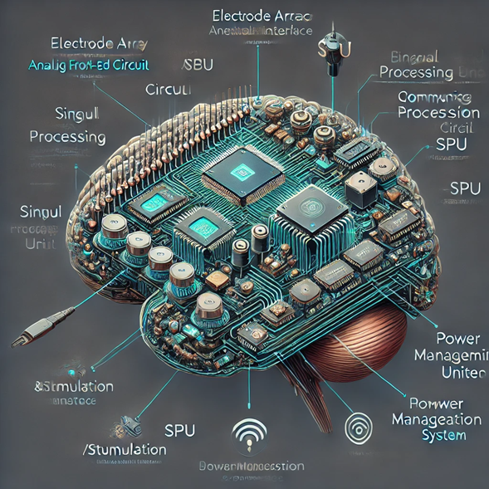
Brain chip diagrams or figures

Slide 12
Brain chip diagrams or figures
• Electrode Array (Neural Interface)
Microscopic electrodes that interact with neurons to send and receive signalCan be invasive (implanted in the brain) or non-invasive (external sensors).
• Analog Front-End (AFE) Circuit
Amplifies and filters neural signals.
Converts weak biological signals into usable electrical signals.
• Communication Module
Wireless or wired interface to external systems (computers, prosthetics, etc.).
Uses Bluetooth, RF, or optical transmission

Slide 13
Brain chip diagrams or figures
• Signal Processing Unit (SPU)
Extracts meaningful information from raw neural data.
Can include AI and machine learning for pattern recognition.
• Memory & Data Storage
Stores recorded neural activity.
Can be used for learning and adaptive responses.
• Feedback & Stimulation System
Can send electrical impulses back to the brain for therapy or control.

Slide 14
Brain chip related comparative technology
1. Neuralink (Elon Musk's Company)
Ultra-thin flexible electrodes (less damage to brain tissue).
Wireless communication with external devices.
Robot-assisted precise implantation.
High-bandwidth neural data transfer. Applications: Medical (paralysis treatment), AI-enhanced cognition, communication.

Slide 15
Brain chip related comparative technology
2. Synchron (Stentrode)
Implanted through blood vessels (minimally invasive).
Uses stent-like electrodes to detect brain signals.
Low risk compared to direct brain implantation. Applications: Restoring mobility, speech assistance for ALS patients.

Slide 16
Brain chip related comparative technology
3. BrainGate
Uses a multi-electrode array for precise signal capture.
Requires an external wired connection for data transfer.
Proven effectiveness in restoring movement control. Applications: Restoring motor function in paralyzed patients.

Slide 17
conclusion
Brain chips are an exciting technology that can help people by improving brain functions, treating diseases, and even connecting the brain to computers. They could help people with paralysis move again or assist those with memory loss. Scientists and companies are working hard to make these chips safe and useful.
However, there are also risks, like privacy concerns and possible health issues. It’s important to test them properly and make rules to protect people.
In simple terms, brain chips could change lives for the better, but we need to be careful and responsible in using them.

Slide 18
THANK YOU!!

